Slide 1
White-box Testing

Slide 2
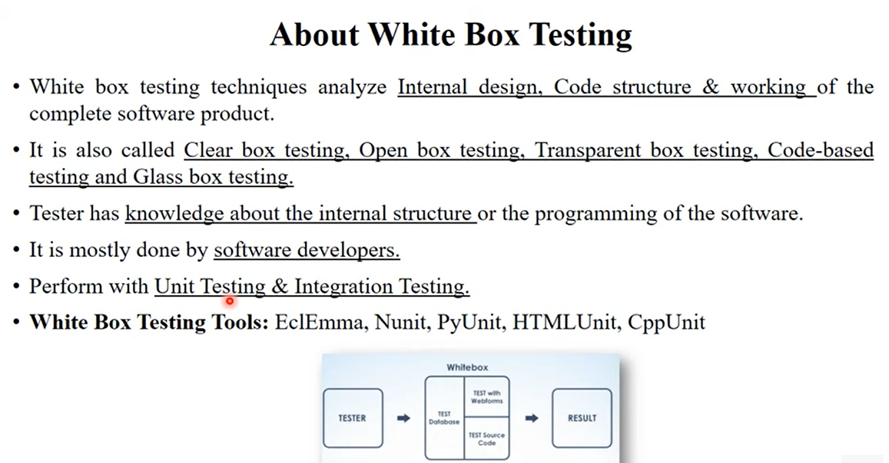

Slide 3
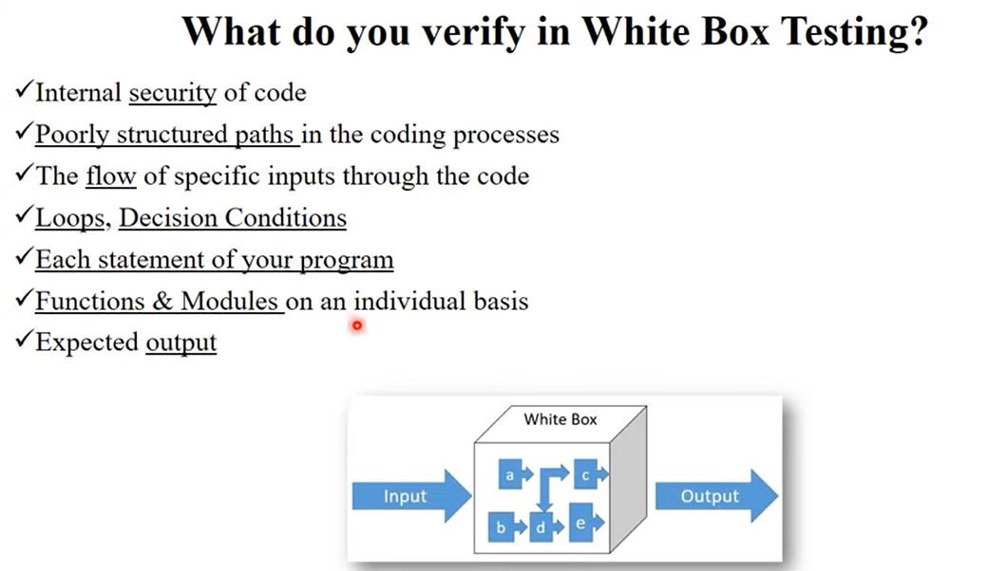

Slide 4
White-Box Testing
There exist several popular white-box testing methodologies:
  Statement coverage
  branch coverage/decision
  path coverage
  condition coverage

Slide 5
Question
Which of the following testing is also known as white box testing?
Functional testing
Stress testing
Structural testing
System testing

Slide 6
Statement Coverage
Statement coverage methodology:
  design test cases so that
    every statement in a program is executed at least once.

Slide 7
Statement Coverage
The principal idea:
  unless a statement is executed,
  we have no way of knowing if an error exists in that statement.

Slide 8
Example
int f1(int x, int y){
1 while (x != y){
2 if (x>y) then
3 x=x-y;
4 else y=y-x;
5 }
6 return x; }
Euclid's GCD Algorithm

Slide 9
Example
print (int a, int b) {
int sum = a+b;
if (sum>0)
print ("This is a positive result")
else
print ("This is negative result")
}

Slide 10
Branch Coverage/ Edge Testing
Test cases are designed such that:
  different branch conditions
    given true and false values in turn.

Slide 11
Branch Coverage
Branch testing guarantees statement coverage:
  a stronger testing compared to the statement coverage-based testing.

Slide 12
Example
int f1(int x,int y){
1 while (x != y){
2 if (x>y) then
3 x=x-y;
4 else y=y-x;
5 }
6 return x; }

Slide 13
Example
Test cases for branch coverage can be:
{(x=3,y=3),(x=3,y=2), (x=4,y=3), (x=3,y=4)}

Slide 14
Condition Coverage
Condition coverage is also known as Predicate Coverage in which each one of the Boolean expression have been evaluated to both TRUE and FALSE.

Slide 15
Example
Consider the conditional expression
  ((c1.and.c2).or.c3):
Each of c1, c2, and c3 are exercised at least once,
  i.e. given true and false values.

Slide 16
Branch testing
Condition testing
  stronger testing than branch testing:
Branch testing
  stronger than statement coverage testing.

Slide 17
Condition coverage
Consider a boolean expression having n components:
  for condition coverage we require 2^{n} test cases.

Slide 18
Path Coverage
Design test cases such that:
  all linearly independent paths in the program are executed at least once.

Slide 19
Linearly independent paths
Defined in terms of
  control flow graph (CFG) of a program.

Slide 20
Path coverage-based testing
To understand the path coverage-based testing:
  we need to learn how to draw control flow graph of a program.

Slide 21
if A = 10 then
if B > C
A = B
else A = C
endif
endif
print A, B, C

Slide 22
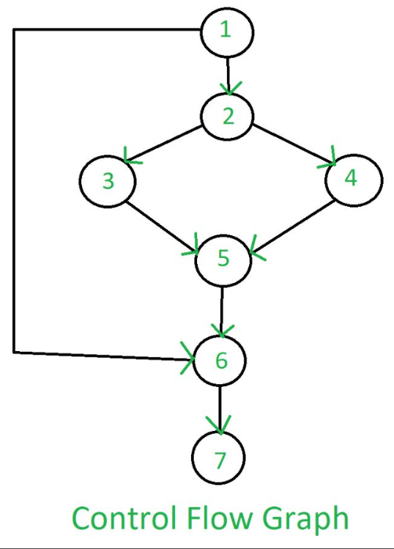

Slide 23
Question
Which of the following is the strongest coverage?
Statement coverage
Branch coverage
Conditional coverage
Data flow-based testing

Slide 24
Control flow graph (CFG)
A control flow graph (CFG) describes:
  the sequence in which different instructions of a program get executed.
  the way control flows through the program.

Slide 25
How to draw Control flow graph?
Number all the statements of a program.
Numbered statements:
  represent nodes of the control flow graph.

Slide 26
How to draw Control flow graph?
Sequence:
  1 a=5;
  2 b=a*b-1;
1
2

Slide 27
How to draw Control flow graph?
Selection:
  1 if(a>b) then
  2 c=3;
  3 else c=5;
  4 c=c*c;
1
2
3
4

Slide 28
How to draw Control flow graph?
1
Iteration:
  1 while(a>b){
  2 b=b*a;
  3 b=b-1;}
  4 c=b+d;
2
3
4

Slide 29
Example
int f1(int x,int y){
1 while (x != y){
2 if (x>y) then
3 x=x-y;
4 else y=y-x;
5 }
6 return x; }

Slide 30
Example Control Flow Graph
1
2
3
4
5
6

Slide 31
Path
A path through a program:
  a node and edge sequence from the starting node to a terminal node of the control flow graph.
  There may be several terminal nodes for program.

Slide 32
Independent path
Any path through the program:
  introducing at least one new node:
    that is not included in any other independent paths.

Slide 33
Independent path
It is straight forward:
  to identify linearly independent paths of simple programs.
For complicated programs:
  it is not so easy to determine the number of independent paths.

Slide 34
McCabe's cyclomatic metric
An upper bound:
  for the number of linearly independent paths of a program
Provides a practical way of determining:
  the maximum number of linearly independent paths in a program.

Slide 35
McCabe's cyclomatic metric
Given a control flow graph G,
cyclomatic complexity V(G):
  V(G)= E-N+2
    N is the number of nodes in G
    E is the number of edges in G

Slide 36
Example Control Flow Graph
1
2
3
4
5
6

Slide 37
Example
Cyclomatic complexity =
7-6+2 = 3.

Slide 38
Cyclomatic complexity
Another way of computing cyclomatic complexity:
  inspect control flow graph
  determine number of bounded areas in the graph
V(G) = Total number of bounded areas + 1

Slide 39
Bounded area
Any region enclosed by a nodes and edge sequence.

Slide 40
Example Control Flow Graph
1
2
3
4
5
6

Slide 41
Example
From a visual examination of the CFG:
  the number of bounded areas is 2.
  cyclomatic complexity = 2+1=3.

Slide 42
Cyclomatic complexity
McCabe's metric provides:
    a quantitative measure of testing difficulty and the ultimate reliability
Intuitively,
  number of bounded areas increases with the number of decision nodes and loops.

Slide 43
Cyclomatic complexity
The first method of computing V(G) is amenable to automation:
  you can write a program which determines the number of nodes and edges of a graph
  applies the formula to find V(G).

Slide 44
Cyclomatic complexity
Defines the number of independent paths in a program.
Provides a lower bound:
  for the number of test cases for path coverage.

Slide 45
Cyclomatic complexity
Knowing the number of test cases required:
  does not make it any easier to derive the test cases,
  only gives an indication of the minimum number of test cases required.

Slide 46
Path testing
The tester proposes:
  an initial set of test data using his experience and judgement.

Slide 47
Path testing
A dynamic program analyzer is used:
  to indicate which parts of the program have been tested
  the output of the dynamic analysis
    used to guide the tester in selecting additional test cases.

Slide 48
Derivation of Test Cases
Let us discuss the steps:
  to derive path coverage-based test cases of a program.

Slide 49
Derivation of Test Cases
Draw control flow graph.
Determine V(G).
Determine the set of linearly independent paths.
Prepare test cases:
  to force execution along each path.

Slide 50
Example
int f1(int x,int y){
1 while (x != y){
2 if (x>y) then
3 x=x-y;
4 else y=y-x;
5 }
6 return x; }

Slide 51
Example Control Flow Diagram
1
2
3
4
5
6

Slide 52
Derivation of Test Cases
Number of independent paths: 3
  1,6 test case (x=1, y=1)
  1,2,3,5,1,6 test case(x=1, y=2)
  1,2,4,5,1,6 test case(x=2, y=1)

Slide 53
An interesting application of cyclomatic complexity
Relationship exists between:
  McCabe's metric
  the number of errors existing in the code,
  the time required to find and correct the errors.

Slide 54
Cyclomatic complexity
Cyclomatic complexity of a program:
  also indicates the psychological complexity of a program.
  difficulty level of understanding the program.

Slide 55
Cyclomatic complexity
From maintenance perspective,
  limit cyclomatic complexity
    of modules to some reasonable value.
  Good software development organizations:
    restrict cyclomatic complexity of functions to a maximum of ten or so.

